Slide 1
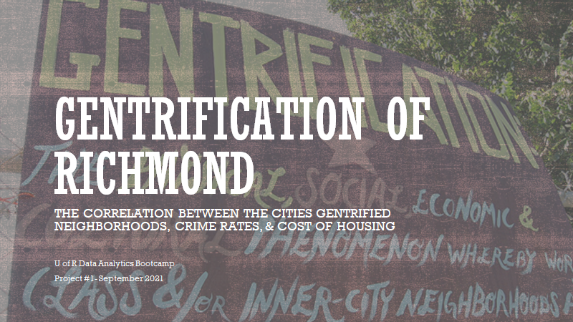

Slide 2


Slide 3
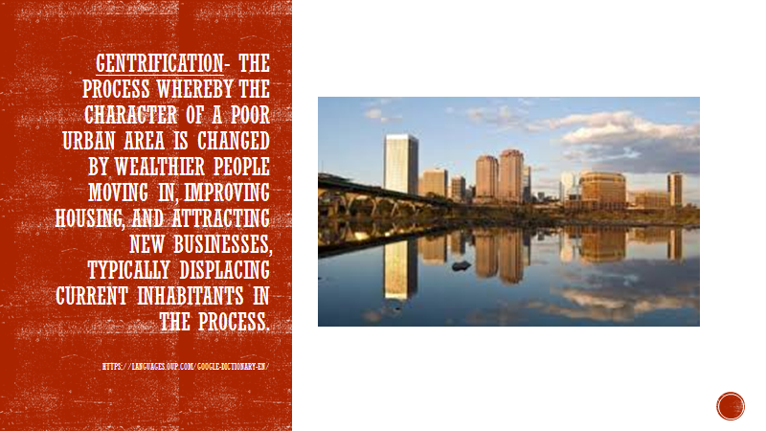

Slide 4
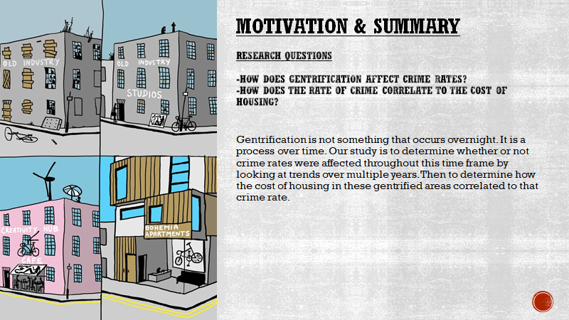

Slide 5
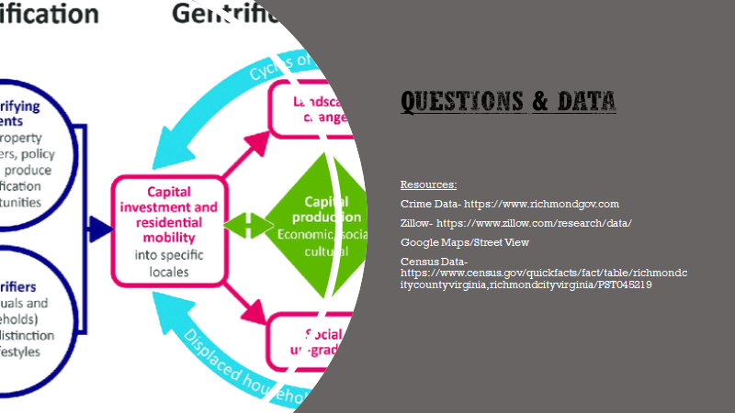

Slide 6
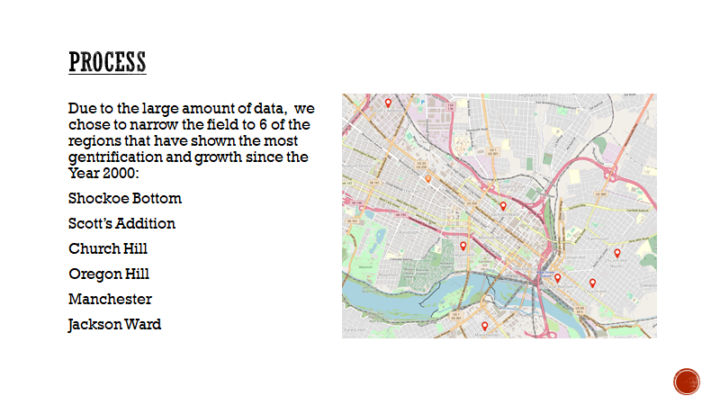

Slide 7


Slide 8
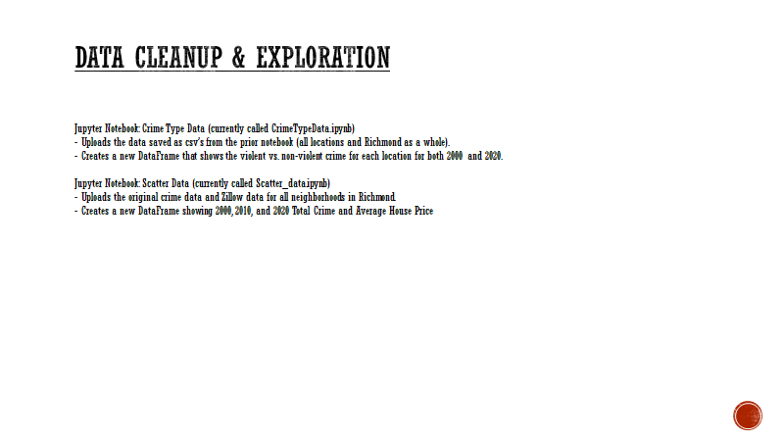

Slide 9
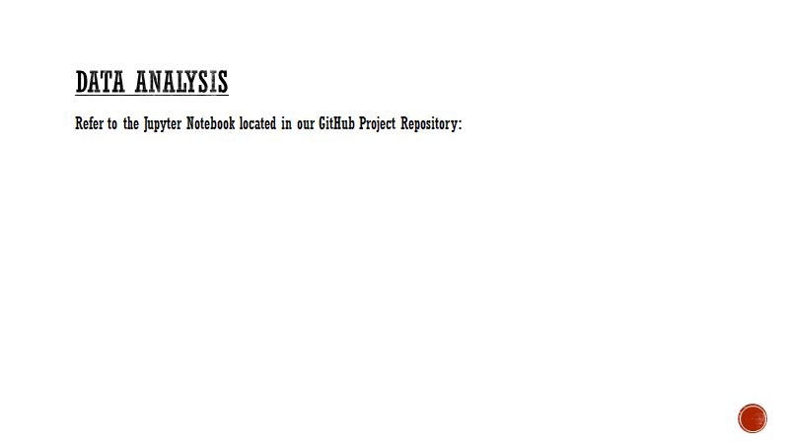

Slide 10
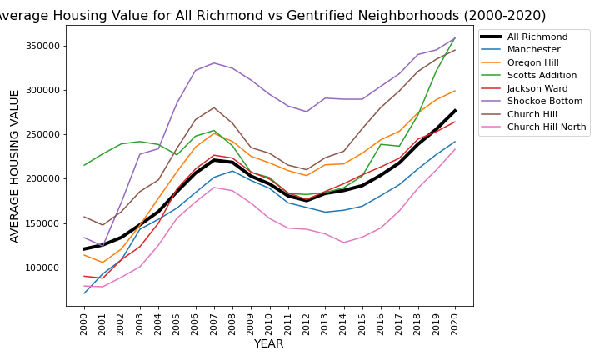
Line graph of all neighborhoods Avg House Price 2000-2020
Black line- Richmond used as Normal Control
Summary evaluation- All Neighborhoods showed an increase in average home value price.

Slide 11
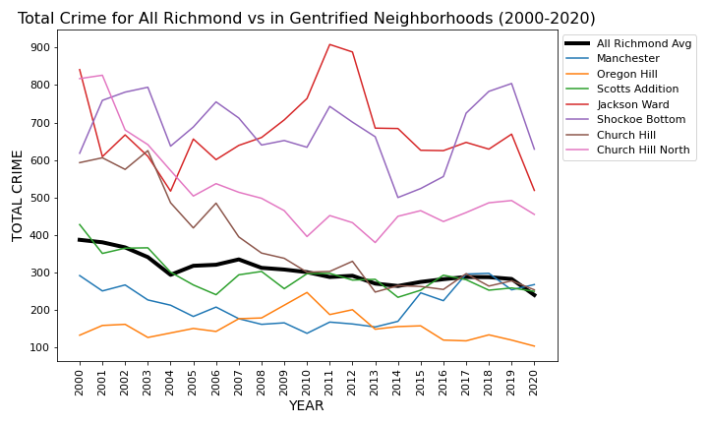
Line graph of all neighborhoods reported Crime 2000-2020
Black line- Richmond used as Normal Control
Summary evaluation- All Neighborhoods showed a decrease in crime, with the exception of Manchester.
Notes:
All areas showed a reduction in crime, except for Manchester.
The data collected for this study does not provide additional insights necessary to determine what factors affected Manchester crime.

Slide 12
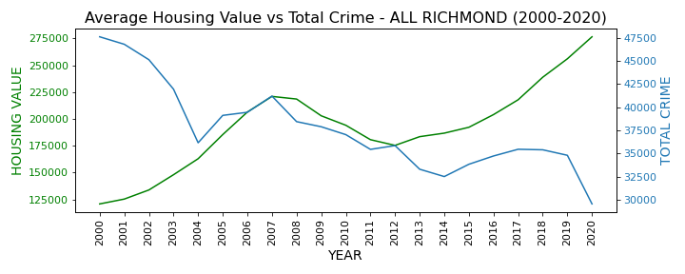
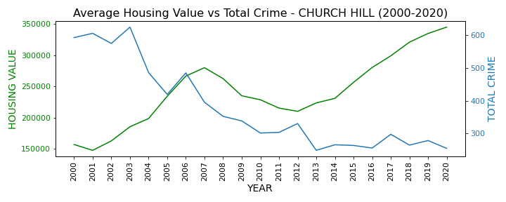
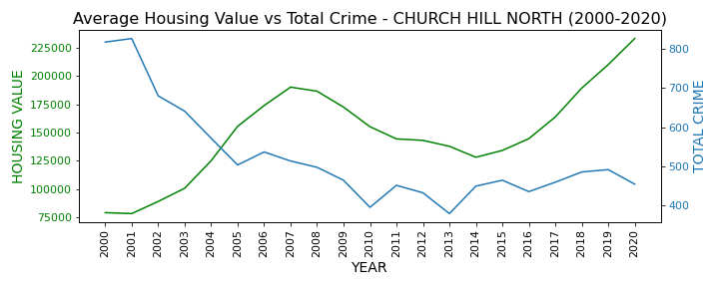
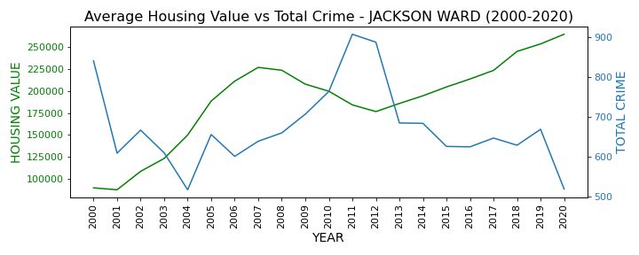
Line graph Crime vs Housing Value 2000-2020
Expected value - inverse relationship.
Summary evaluation- All Neighborhoods show expected value with the exception of Manchester. - See next slide for more.

Slide 13
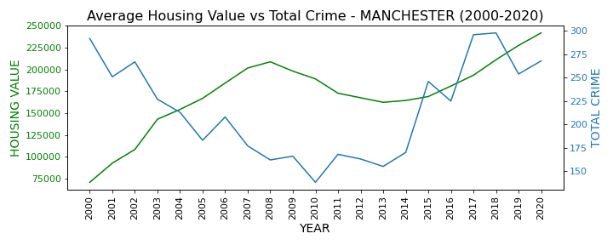
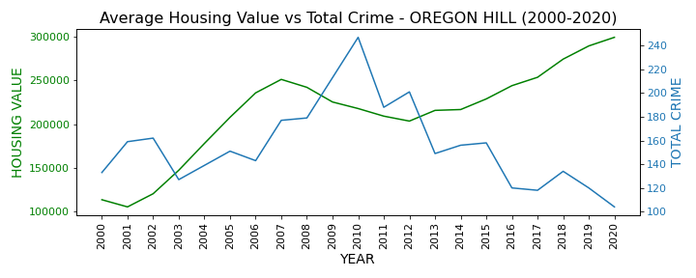
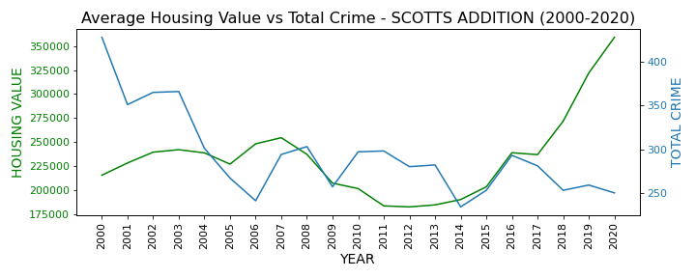
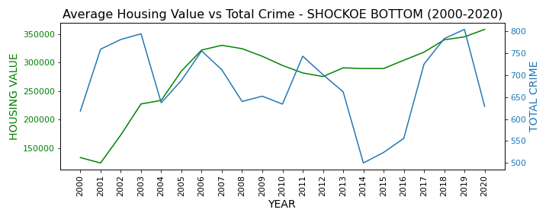
Notes:
Manchester shows slight increase in crime. Further studies necessary to determine factors influencing crime in Manchester.

Slide 14
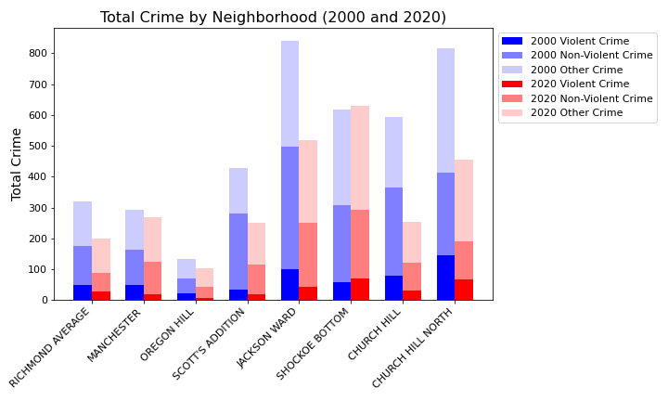
Crime Type bar analysis using start ‘2000’ and end ‘2020’
Expected value - reduction in violent crimes.
Formula used = Violent Crimes (Homicide,Sex Offense, Robbery, and Assault), Non-Violent Crimes (Burglary, Theft, Vice, and Vehicle Theft), and Other.
All neighborhood performed as expected except for Shockoe Bottom showing slight increase in violent crime.
Notes:
Shockoe Bottom showed a slight increase in violent crimes 2020 = 59 reports and 2020 = 70 reports. The most reported violent crime was assault.

Slide 15
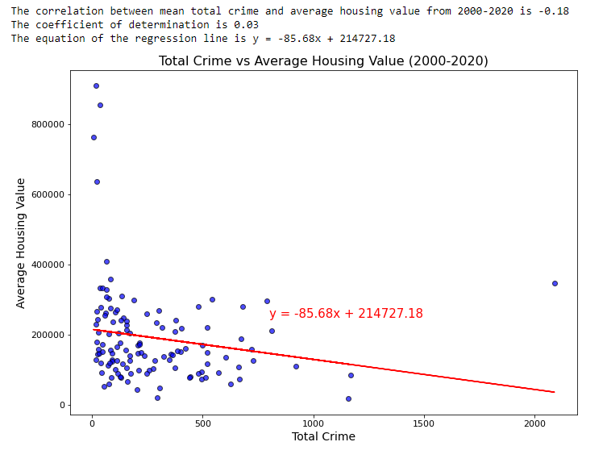
Scatter Plot Total Crime vs Average House Value 2000-2020
Expected Value - strength of correlation >0.7.
Summary evaluation - strength of correlation -0.18 = very weak correlation.

Slide 16
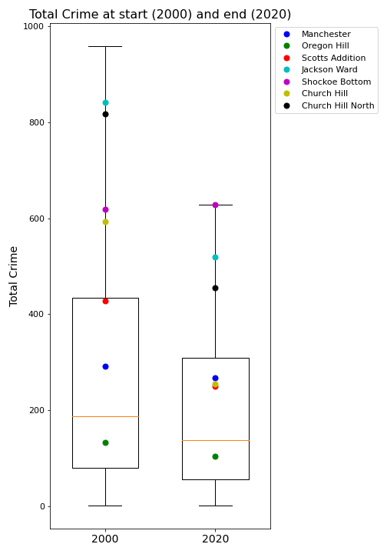
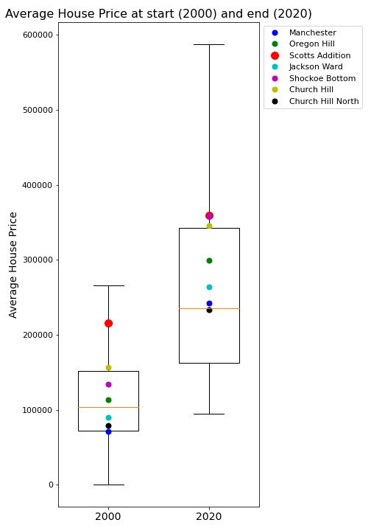
Box and Whisker analysis using start ‘2000’ and end ‘2020’
Expected Value - decrease distribution in 2020.
Overall expected value seen.

Slide 17
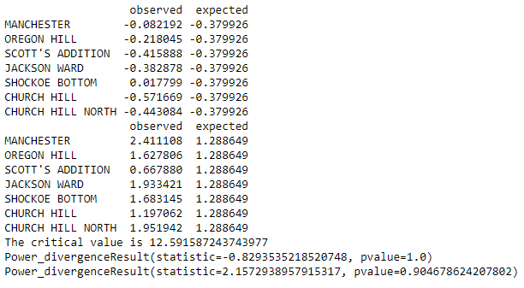
Chi Square analysis using start ‘2000’ and end ‘2020’
Expected value = pvalue <0.05, 95% confidence level.
Summary Analysis - Crime pvalue=1.0, 90% confidence level, Average House Value pvalue=0.90, 91%confidence level. Significance level = low.
Crime
Average House Value
Notes:
Our studies yielded a low significance level.

Slide 18
Discussion

Slide 19
POST MORTEM
Difficulties That Arose:
Time barriers
Differences in source data
Additional Questions That Arose:
Are other factors such contributing to crime such as poverty rate, population, and residential demographics.
How did the overall demographics of home owners and business owners change as the neighborhoods developed.
What we would study next (If we had 2 more weeks):
Pull more meaningful information from Census API.
Find statistics on what type of commercial development had occurred within each neighborhood.
Determine population demographics at beginning and end.

Slide 20



